Slide 1

SHAREBILLS
A database project on simplified expense sharing among users
Subhash Daggubati
Tejaswi Lakkakula
BalaPavan Kommareddy
Sandeep Anuguthala
Anup Kumar Chittimalla

Slide 2
DATABASE PLANNING
MISSION STATEMENT
Sharebill's mission is to make shared living and travel easier by providing neutral advice, fair judgement, and simplified expense sharing through Database management system.

Slide 3
DATABASE DESIGN
BUSINESS RULES
ShareBills is a database where transactions of all shared expenses between users is stored.
ShareBills can get transactions from individual users and users from different groups.
Each user can be a part of none of the group or several groups.
Each group can have two or more users.
Every transaction involves two or more users. For example, Walmart expense is a transaction of common groceries with the amount of 200 USD that involved multiple users made on a particular day.
Each user can have zero or many transactions.
For each user there is zero settle up request or many settle up requests.
Every user is identified by User ID. The first name, last name, middle name, email id, and phone number of all users are recorded in the system.

Slide 4
A borrower can send a settle up request to lender once he repays the amount lent from borrower. Once the lender approves the settle up request, the rows in the Transaction detail entity will be updated.
Transaction detail entity has information about transaction id, borrower id, debt amount, settled up flag, and settle up request id.
For every group, group id, group name and group created date is maintained.
Every single settle up request is known by Request id. In addition, request made by a user, request sent to a user with the request status, request received date, request accepted date, and request group id is stored in the system.
A particular transaction is recognized by transaction id. Transaction owner id, Lender id along with the transaction group id, transaction date, transaction amount, and a transaction comment are also kept in the database.

Slide 5
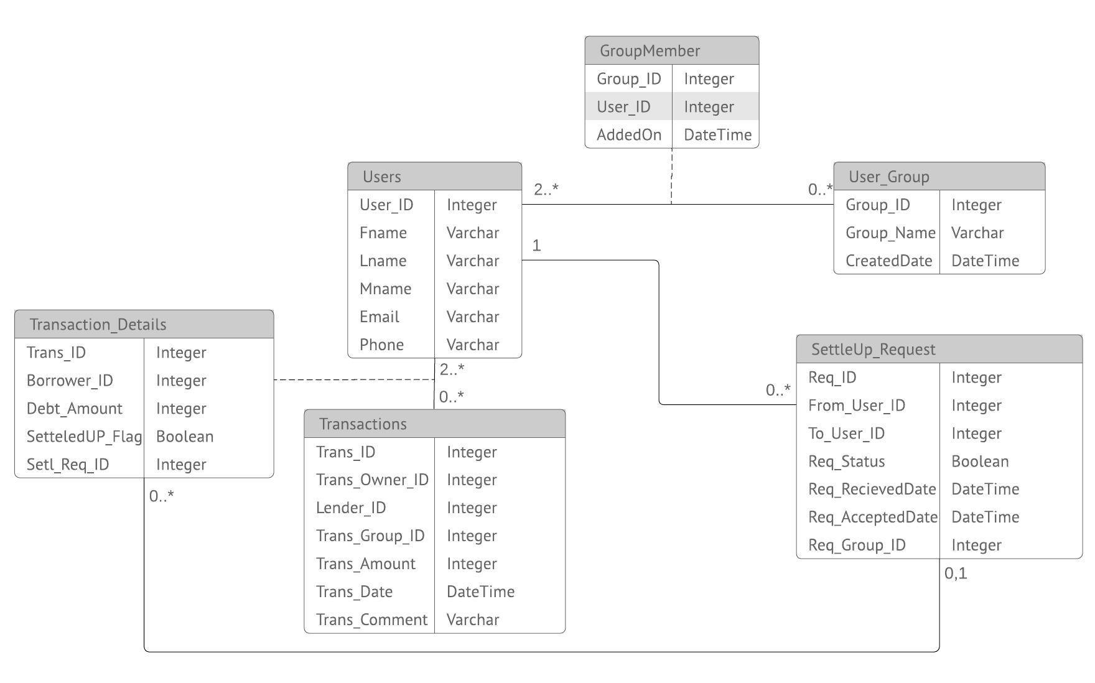
ERD DIAGRAM

Slide 6
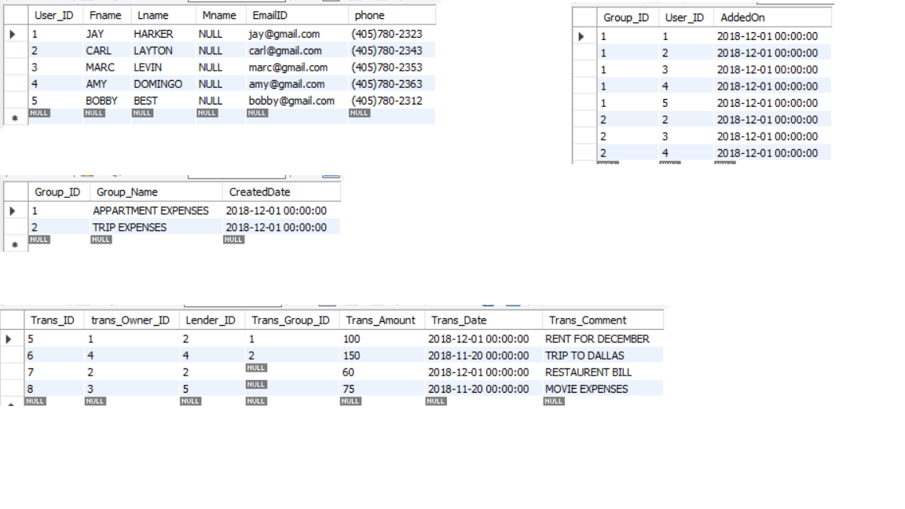
TABLES

Slide 7
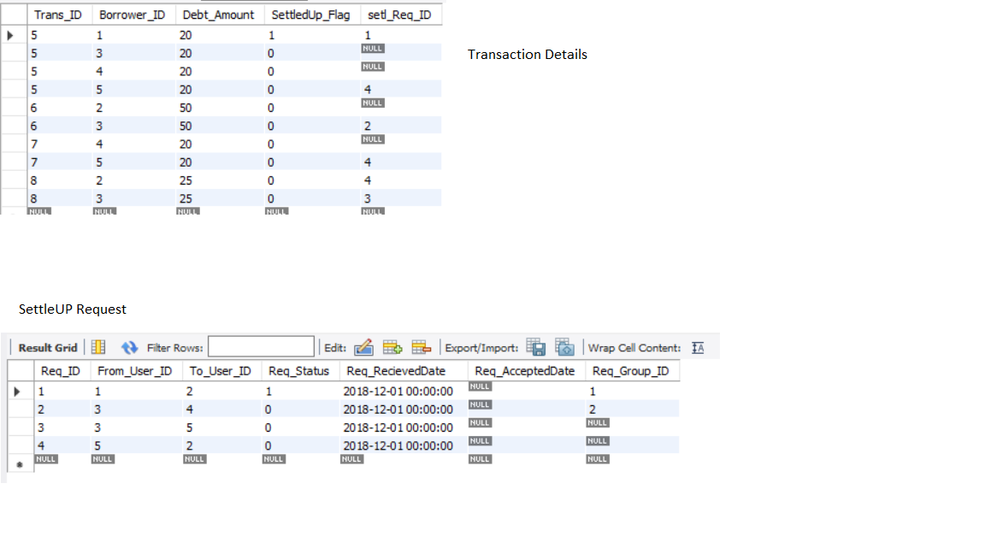

Slide 8
STORED PROCEDURE
CREATE PROCEDURE `Insert_Transaction_Details` (IN INPUT TEXT,
IN delimiter VARCHAR(10), IN debt_amount Int, in trans_id int)
BEGIN
DECLARE cur_position INT DEFAULT 1 ;
DECLARE remainder TEXT;
DECLARE cur_string VARCHAR(1000);
DECLARE delimiter_length TINYINT UNSIGNED;
SET remainder = input;
SET delimiter_length = CHAR_LENGTH(delimiter);
WHILE CHAR_LENGTH(remainder) > 0 AND cur_position > 0 DO
SET cur_position = INSTR(remainder, delimiter);
IF cur_position = 0 THEN
SET cur_string = remainder;
ELSE
SET cur_string = LEFT(remainder, cur_position - 1);
END IF;

Slide 9
IF TRIM(cur_string) != '' THEN
INSERT INTO transaction_details (Trans_ID, Borrower_ID, Debt_Amount,SettledUp_Flag) VALUES (trans_ID,cast(cur_string as unsigned), debt_amount,0);
commit;
END IF;
SET remainder = SUBSTRING(remainder, cur_position + delimiter_length);
END WHILE;
END

Slide 10
TRIGGERS - 1
/*AFTER INSERT SETTLEUP_REQUEST*/
CREATE DEFINER=`root`@`localhost` TRIGGER `settleup_request_AFTER_INSERT` AFTER INSERT ON `settleup_request` FOR EACH ROW BEGIN
if (NEW.Req_Group_ID is not null) then
UPDATE Transaction_Details
SET
setl_Req_ID = NEW.Req_ID
WHERE
(borrower_id = NEW.FROM_USER_ID OR borrower_id = NEW.TO_USER_ID) and setl_Req_ID IS NULL AND
Trans_ID IN (SELECT
td.trans_ID
FROM
(select * from transaction_details) td join transactions t on t.trans_id = td.trans_id
where t.trans_group_id = NEW.Req_Group_ID and (t.lender_id = NEW.From_User_ID or t.lender_id = NEW.To_User_ID )
AND ( td.borrower_id = NEW.To_User_ID or td.borrower_id = NEW.From_User_ID));

Slide 11
else
UPDATE Transaction_Details
SET
setl_Req_ID = NEW.Req_ID
WHERE
(borrower_id = NEW.FROM_USER_ID OR borrower_id = NEW.TO_USER_ID) and setl_Req_ID IS NULL AND
Trans_ID IN (SELECT
td.trans_ID
FROM
(select * from transaction_details) td join transactions t on t.trans_id = td.trans_id
where (t.lender_id = NEW.From_User_ID or t.lender_id = NEW.To_User_ID )
AND ( td.borrower_id = NEW.To_User_ID or td.borrower_id = NEW.From_User_ID));
End if;
END

Slide 12
TRIGGERS – 1I
/*AFTER UPDATE SETTLEUP REQUEST*/
CREATE DEFINER=`root`@`localhost` TRIGGER `settleup_request_AFTER_UPDATE` AFTER UPDATE ON `settleup_request` FOR EACH ROW BEGIN
IF (OLD.Req_Status =0 and NEW.Req_Status=1) THEN
Update Transaction_Details set Settledup_Flag = 1 where Setl_Req_ID = OLD.Req_ID;
END IF;
END

Slide 13
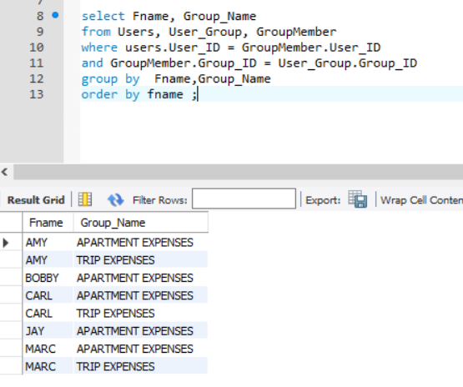
SQL SAMPLE QUERY
Display the names of all groups a user is part of.

Slide 14


